Slide 1
Models of Privacy & Trust for Africa
Verengai Mabika
Senior Policy Advisor – Africa

Slide 2
The Internet is for Everyone
Join us to keep the Internet open, thriving and benefitting people around the globe.

Slide 3
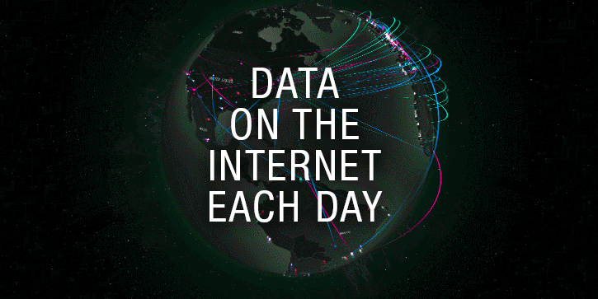

Slide 4
How much data do we produce
"Over 2.5 quintillion bytes of data are created every single day, and it’s only going to grow from there. By 2020, it’s estimated that 1.7MB of data will be created every second for every person on earth."
90% of the world's data has been created in the last two years - this is how, an amazing overview of online usage growth.

Slide 5
How Much Data does google store a day
On average, Google now processes more than 40,000 searches EVERY second (3.5 billion searches per day)!
While 77% of searches are conducted on Google, other search engines are also contributing to our daily data generation.
Worldwide there are 5 billion searches a day.

Slide 6
Data on services – every minute
The Weather Channel receives 18,055,556 forecast requests
Venmo processes $51,892 peer-to-peer transactions
Spotify adds 13 new songs
Uber riders take 45,788 trips!
There are 600 new page edits to Wikipedia

Slide 7
Communication – every minute
We send 16 million text messages
There are 990,000 Tinder swipes
156 million emails are sent; worldwide it is expected that there will be 9 billion email users by 2019
15,000 GIFs are sent via Facebook messenger
Every minute there are 103,447,520 spam emails sent
There are 154,200 calls on Skype

Slide 8
State of Trust & Security online

Slide 9
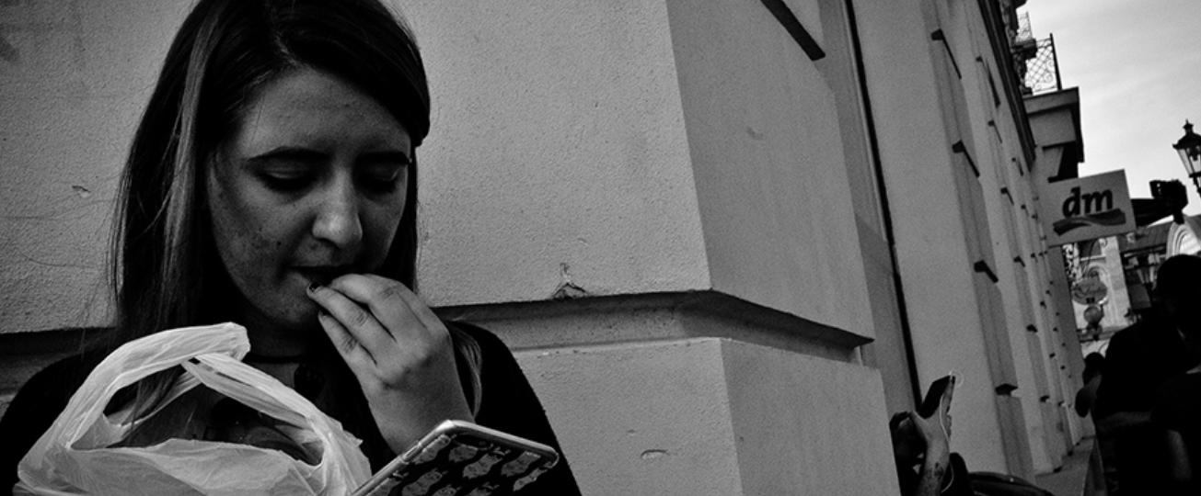
Survey on Security and Trust Online https://www.cigionline.org/internet-survey-2019

Slide 10
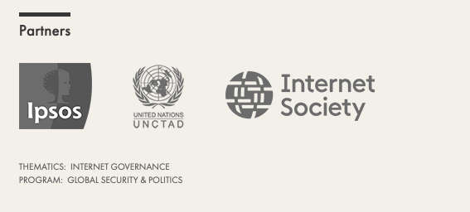
The Survey
Five surveys from 2014 (2015) – 2019
25 economies
25,000+ Internet users surveyed each iteration.
Created by the Centre for International Governance Innovation (CIGI)
    Carried out by Ipsos
    Supported by UNCTAD 2017 -
    Supported by the Internet Society 2017 -

Slide 11
Economies surveyed:
Australia,
Brazil,
Canada,
China,
Egypt,
France,
Germany,
Great Britain,
Hong Kong,
India,
Indonesia,
Italy,
Japan,
Kenya,
Mexico,
Nigeria,
Pakistan,
Poland,
South Africa,
South Korea,
Sweden,
Tunisia,
Turkey, and
United States.

Slide 12
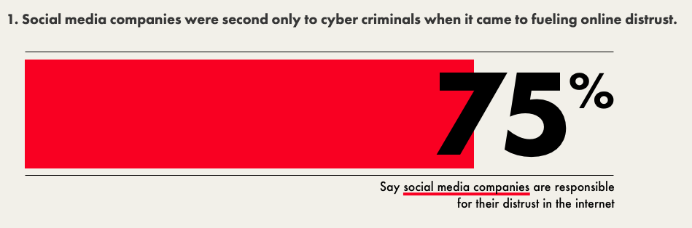

Slide 13
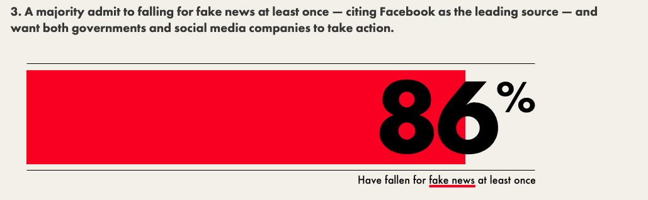

Slide 14
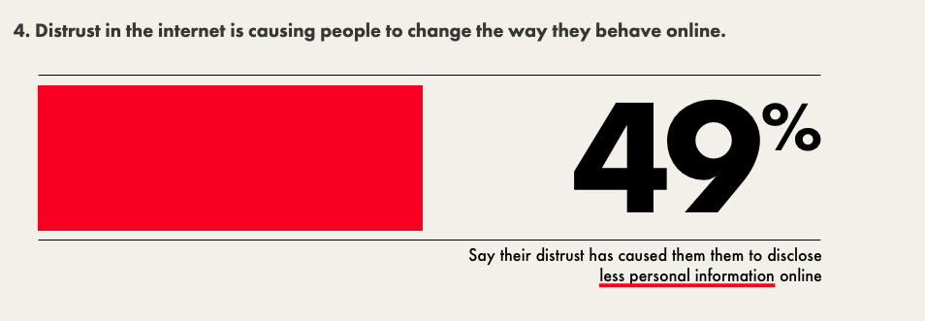

Slide 17

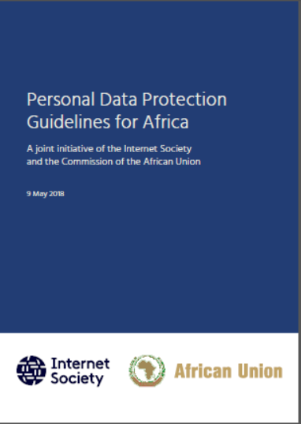
Notes:
Introduction:
Privacy is an essential enabling right which underpins an individual’s autonomy, dignity, personal security, and freedom of expression. However, there is no universally agreed definition of privacy. In the online context, a common understanding of privacy is:
“The right to control when, how, and to what extent personal data is shared with others.”
However, our privacy online is at risk of being undermined. To protect and foster online privacy, we need to:
Promote strong, technology-neutral data privacy laws,
Privacy-by-design principles, and
Ethical data collection and handling principles.

Slide 18
The Guidelines
A step towards developing national legislative frameworks and helping African countries transpose the provisions of the Malabo Convention into national law,
the African Union Commission
Internet Society (ISOC),
Jointly developed the “Personal Data Protection Guidelines for Africa”, which is a detailed set of best practice guidelines on personal data protection.

Slide 19
Why the Guidelines Matter
The Guidelines were developed to help facilitate implementation of the Convention, with its recommended actions tailored to the African environment's unique features, including:
  a shortage of skilled human resources in the area of personal data protection,
  limited resources (including financial) for governments, organizations, and other stakeholders,
  limited levels of awareness of online privacy issues among stakeholders,
  and a general lack of awareness of the risks involved in the use of ICTs.
The Guidelines were created by a multistakeholder group with contributions from regional and global privacy experts, including industry privacy specialists, academics and civil society groups.

Slide 20
The Guidelines recommend the most critical actions to take on Personal Data Protection at the regional, national, and organizational levels.
The Guidelines emphasize the importance of the multistakeholder model and provides recommendations for
Governments and policymakers,
Data protection authorities (DPAs),
Data controllers and their partners and
Citizens and Civil Society

Slide 21
  The Guidelines set out 18 recommendations, grouped under three headings:
  Multi-stakeholder solutions;
  Wellbeing of the digital citizen; and
  Enabling and sustaining measures.
Eight recommendations for action by the following stakeholders:
  Governments and policymakers
  Data Protection Authorities (DPAs)
  Data controllers and data processors

Slide 22
Ask
Member states with an interest in exploring this subject may reach out to AUC or ISOC
Focused Capacity session
Notes:
Introduction:
Privacy is an essential enabling right which underpins an individual’s autonomy, dignity, personal security, and freedom of expression. However, there is no universally agreed definition of privacy. In the online context, a common understanding of privacy is:
“The right to control when, how, and to what extent personal data is shared with others.”
However, our privacy online is at risk of being undermined. To protect and foster online privacy, we need to:
Promote strong, technology-neutral data privacy laws,
Privacy-by-design principles, and
Ethical data collection and handling principles.

Slide 23
Read the full policy brief:
    www.internetsociety.org/policybriefs/privacy/
Notes:
Thank You:
In today’s digital age, while there are beneficial economic and social opportunities that may arise from new uses of personal data, it is important that we address the privacy challenges.
The Internet Society has published a number of papers and additional content related to this issue. A good starting point is the Internet Society’s policy brief on this topic.

